Slide 1
KDIGO Stage 3
≥75%
KDIGO Stage 2
Toggle between eGFRcr and eGFRcys
Max ↓ eGFR
within 7 days
≥50%
KDIGO Stage 1
Color code increased Scr ≥0.3 mg/dL within 48 hours
≥25%
1.5x
2.0x
2.5x
3.0x
Max fold ↑ Scr from baseline within 7 days

Slide 2
KDIGO-DC Stage 3
1.2 mg/dL
KDIGO-DC Stage 2
Delta Creatinine
Increase from baseline
0.7 mg/dL
KDIGO-DC Stage 1
Color code increased Scr ≥0.3 mg/dL within 48 hours
0.3 mg/dL
1.5x
2.0x
2.5x
3.0x
Max fold ↑ Scr from baseline within 7 days

Slide 3
1.5 mg/dL
Serum creatinine
Serum cystatin C
Difference
1 mg/dL
0.5 mg/dL
1
2
3
4
5
6
7
8
Week

Slide 4
60 mL/min
eGFR cr
eGFR cys C
Difference
30 mL/min
10 mL/min
1
2
3
4
5
6
7
8
Week

Slide 5
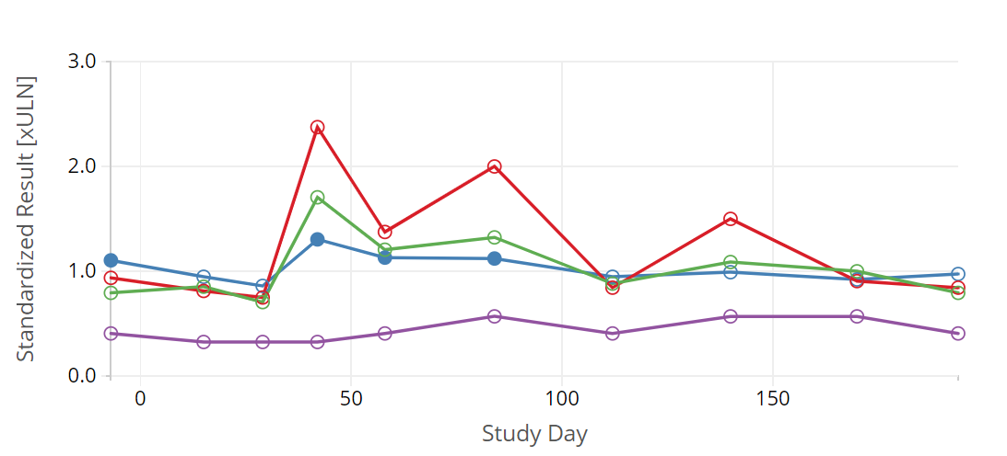
BUN
Sodium
Potassium
Bicarbonate
Chloride
Phosphate
Calcium

Slide 6
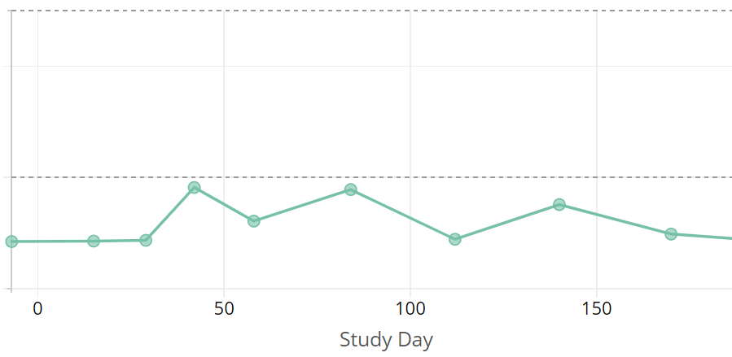
Blood Pressure
150 mm/Hg
100 mm/Hg
50 mm/Hg
Systolic
Diastolic

Slide 7
Urine Albumin / Creatinine Ratio
300 mg/g
30 mg/g

